Slide 1
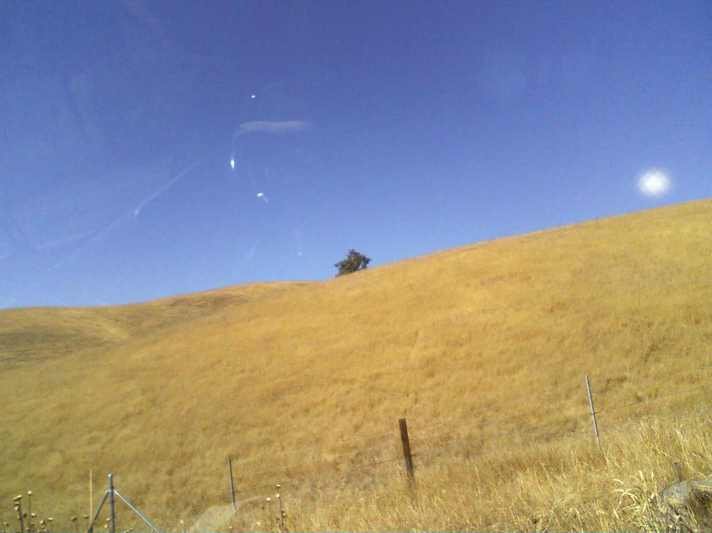
Bartonella Henselae(Lyme Diease)
Thomas Pham
Bio.240

Slide 2
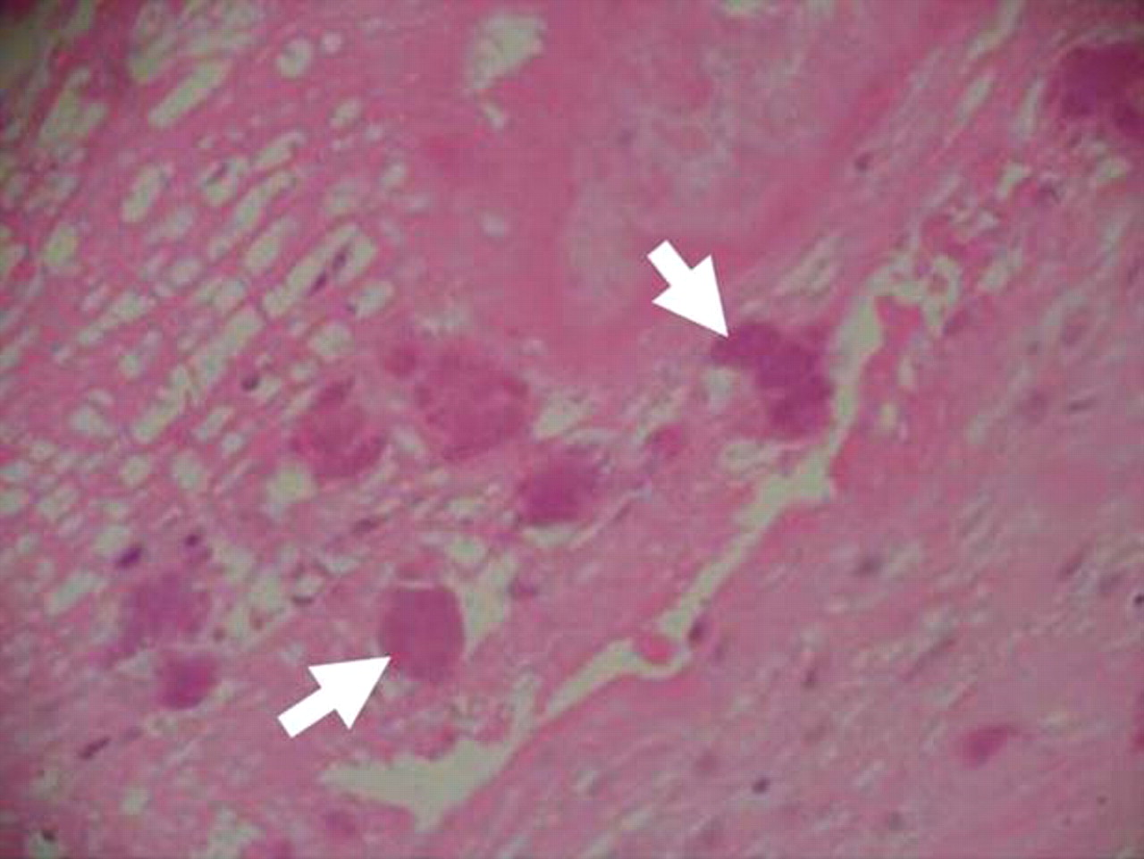
Gram-Stain
Bartonella Henselae stains gram-negative on a gram-stain slide.

Slide 3
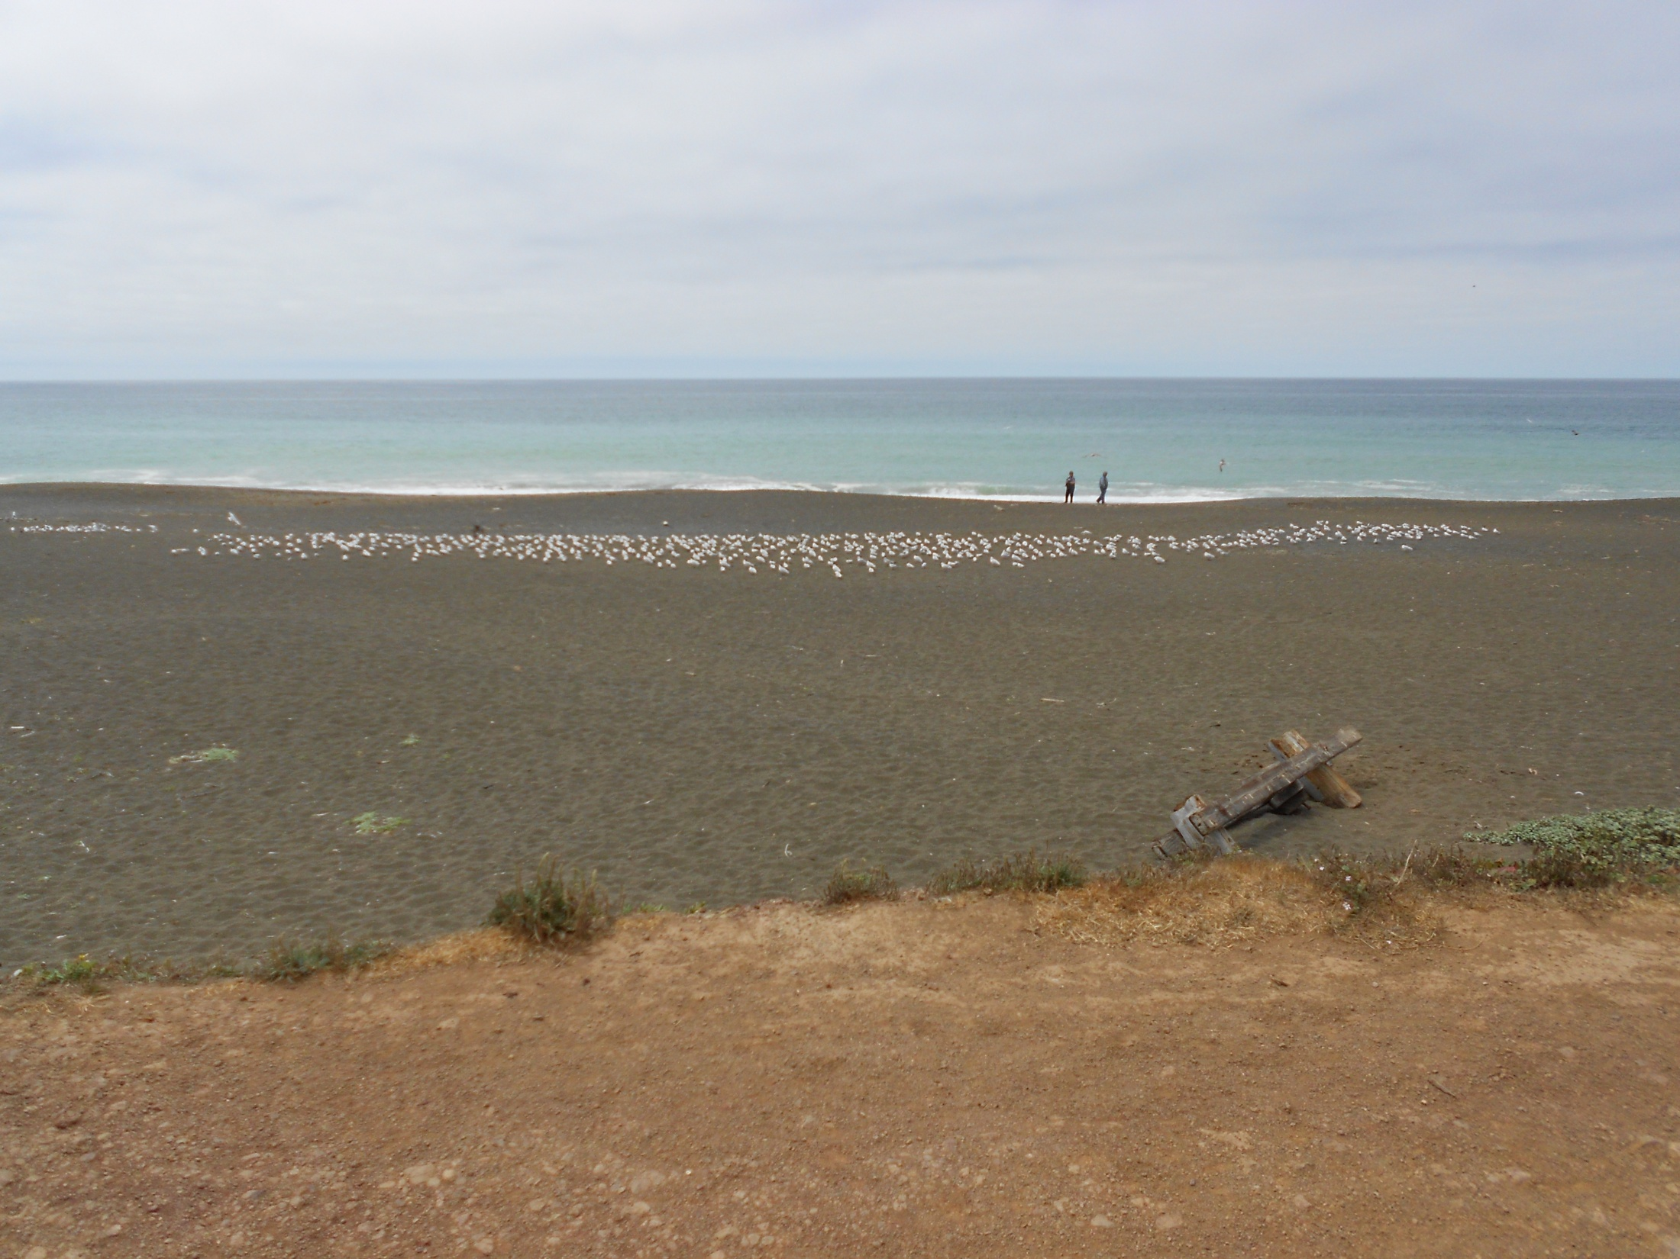

Slide 4
Treatment

Slide 9

Conclusion
I hope you find this presentation helpful.
Thank you for watching this presentation.
Now you know how to prevent this from happening to others.

Slide 10

Questions?
Did you learn anything new?
What did you think of the presentation?
Did this presetation give you a better understanding of Bartonella Henselae?

